Slide 1

Building Google for Criminal Enterprises
Author: Anthony Russell
@DotNetRussell

Slide 2
$>WhoAmI
I do cyber and codes…. Hit me up on twitter if you want to know more
Twitter Profile
@DotNetRussell
Blog
https://www.DotNetRussell.com

Slide 3
Things we’ll cover
How and why this project was started
What is public data and where can you find it
Scraping data
Linking public data to scraped data
Who cares?
How would I fix it
$$ New Tool Demo $$

Slide 4
DISCLAIMER:
We will be looking at sensitive data. These people are innocent and don’t deserve to be harassed.
PLEASE BE RESPECTFUL
I don’t condone the illegal use of any of this material and or research.

Slide 5
On that note….
If the government is going to publish it then it’s fair game for my presentation.
If I redact information then it doesn’t have the intended impact and this is a huge waste of time.
-- I WANT TO MAKE SOMEONE ANGRY --

Slide 6
Also, I spoke to an attorney. Don’t sue me bro…

Slide 7

Why this project?

Slide 8

Why this project?
I want to keep a public profile as a living resume for work opportunities.
However doing that is a challenge because…
I don’t want my data raided…

Slide 9

Take the challenge
As a OIF vet I prefer to take challenges head on

Slide 10
How do we start becoming private?
Opt Out of All the Things
Scrubbed social media of personal info
Muddy the water
Emails
Scrubbed all emails against HIBP and dumped old emails
Do not call list
Uninstalled all apps that require wonky permissions
Researched cleanup services (garbage)

Slide 11

I opted out…..

Slide 12
And opted out….
PeopleFinders Opt-out
http://peoplefinders.com/manage (Find your account and then follow the instr)
Spokeo opt-out
http://www.spokeo.com/opt_out/new
WhitePages opt-out
http://www.whitepages.com/suppression_requests
Phone Detective opt-out
https://www.phonedetective.com/PD.aspx?_act=OptOut
People Smart opt-out
https://www.peoplesmart.com/optout-go
Accutellus opt-out
https://www.accutellus.com/opt_out_request.php

Slide 13
And opted out more….
Ebureau – Opt-Out
http://www.ebureau.com/privacy-center/opt-out
NAI – Opt-Out
http://www.networkadvertising.org/choices
PeekYou – Opt-Out
http://www.peekyou.com/about/contact/optout/
TowerData (Rapleaf) – Opt-Out
https://dashboard.towerdata.com/optout/
DMAChoice Opt-Out (Covers all DMA participants for 6 years)
https://www.ims-dm.com/cgi/optoutemps.php
Epsilon Opt-Out
https://www.epsilon.com/en_US/consumer-information/consumer-preference-center.html

Slide 14
And more….
Intellus
https://www.intelius.com/optout
Acxiom Opt-Out
https://isapps.acxiom.com/optout/optout.aspx
CoreLogic Opt-Out
http://www.corelogic.com/downloadable-docs/teletrack-out-opt-form.pdf
BlueKai – DataLogix – Oracle Data Cloud | Opt-Out
http://bluekai.com/offlineoptout/
DataBrokers Site
https://www.worldprivacyforum.org/2013/12/data-brokers-opt-out/

Slide 15

Unfortunately 6 months later I’m still getting emails for dick pills

Slide 16
Maybe I need a different approach…
Maybe if I build a tool that does what they do….
… but abuses the data instead of sell it for profit…
Maybe then they’ll fix it….

Slide 17
The power of social media is that you can be a dick and people don’t know your home address and phone number…
…Or is there a way

Slide 18
Finding and Collecting Seed Data from Public Sources

Slide 19
Public Data as I Define it ….
Data that is made public by either Local, State, or Federal Governments.
Data that can be collected from social media such as Facebook, LinkedIn, Twitter.
Data that can be returned from API’s like Pipl

Slide 20
Governmental Data
Voter Database - Full Name, DOB, Current Address, Party Affiliation, (99 Columns of Data)
Property Records - Full Name of owners, Current Address, Property Sale Price, Tax information, Property Layout
Traffic Violations - Full Name, DOB, Current Address, Offenses
Pet Registration - Name and address
Car Registration?

Slide 21
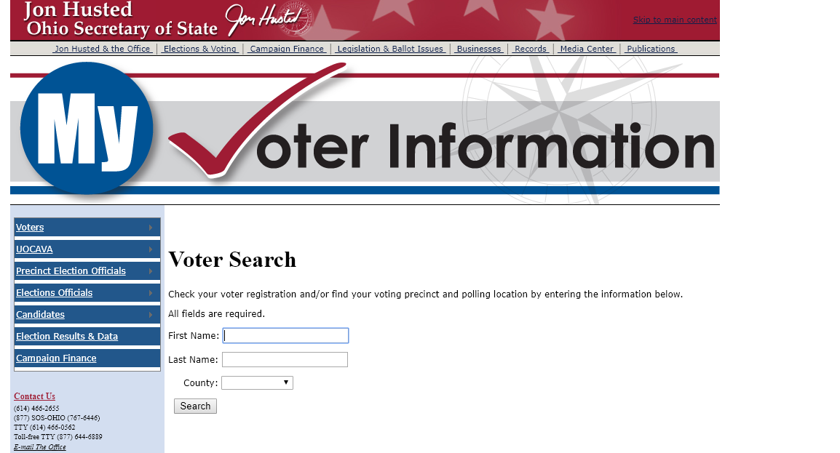

Slide 22
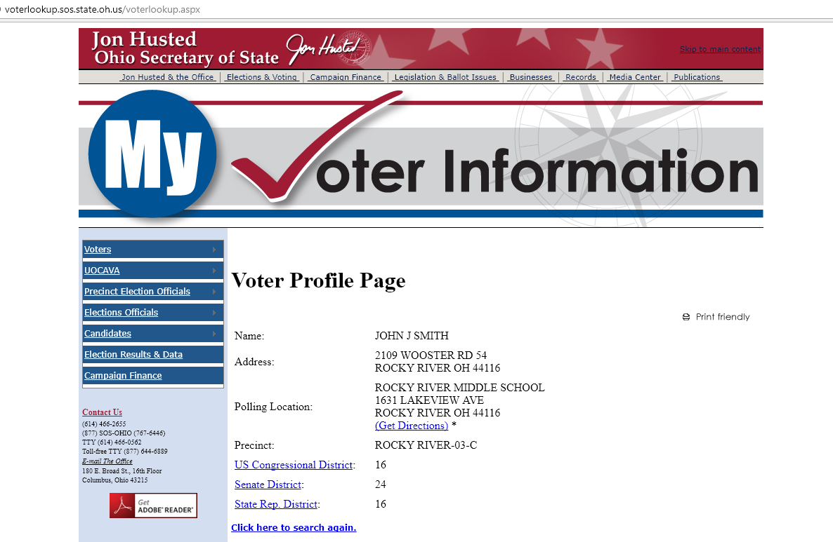

Slide 23
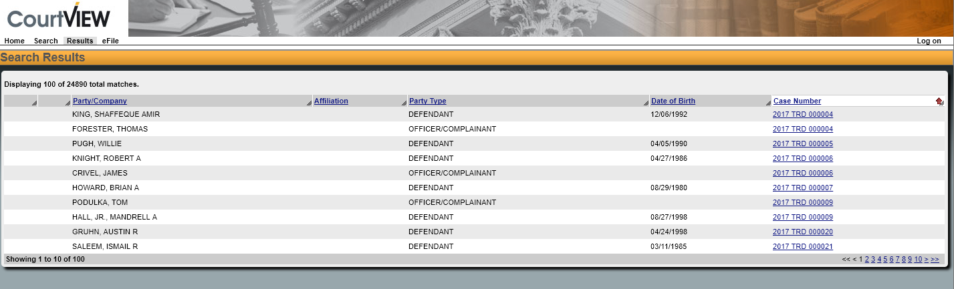
Traffic Violations From 1-Jan-2017 to 22-July-2017 (24,890 results)

Slide 24
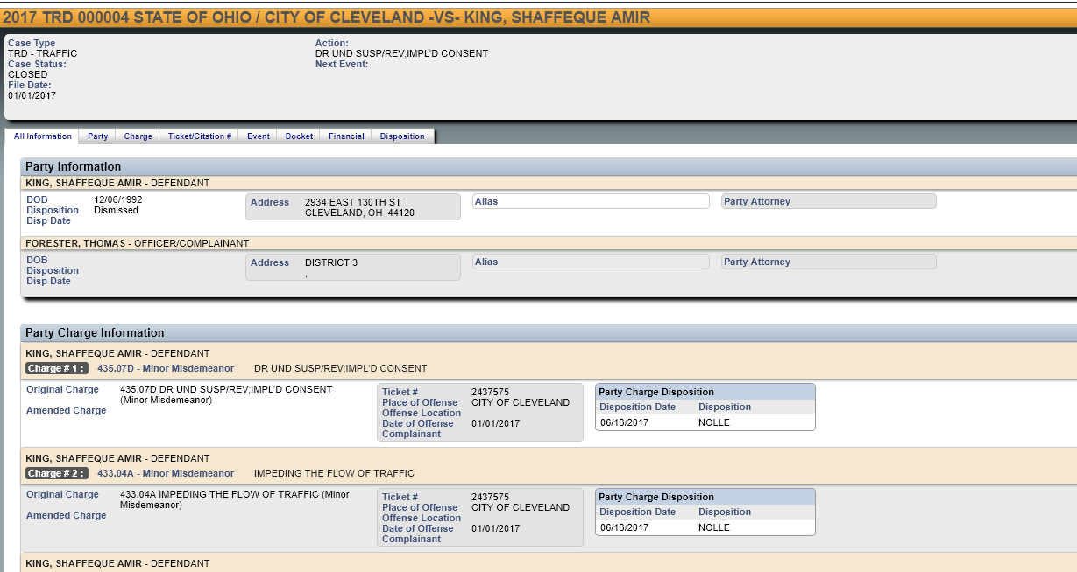

Slide 25
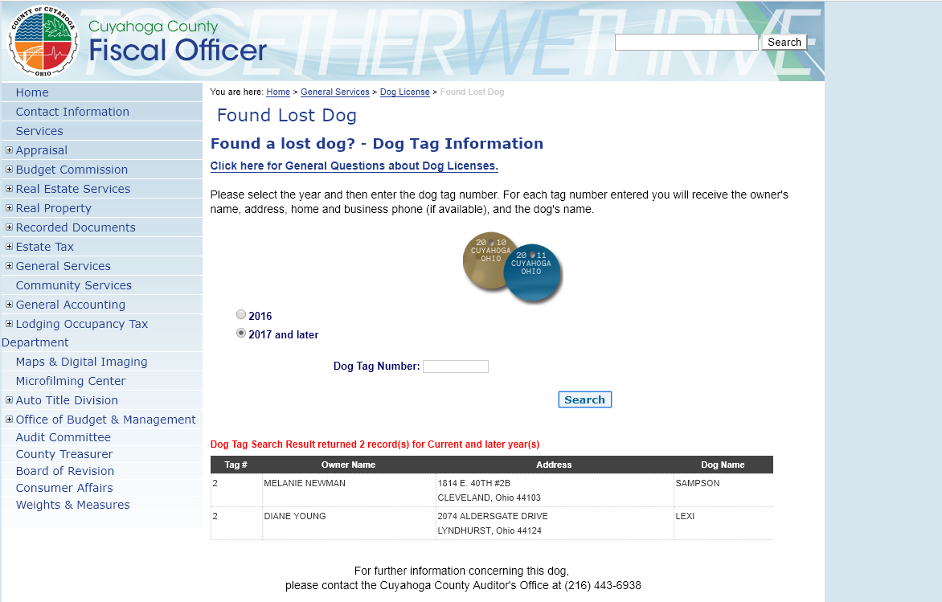

Slide 26
The Data I didn’t Use and Why
Property Records
Traffic Violations
Pet Registration
Simple, there was a different site for every county and I didn’t want to script every site individually. Download of the database wasn’t possible but there is a TON of valuable info there.

Slide 27
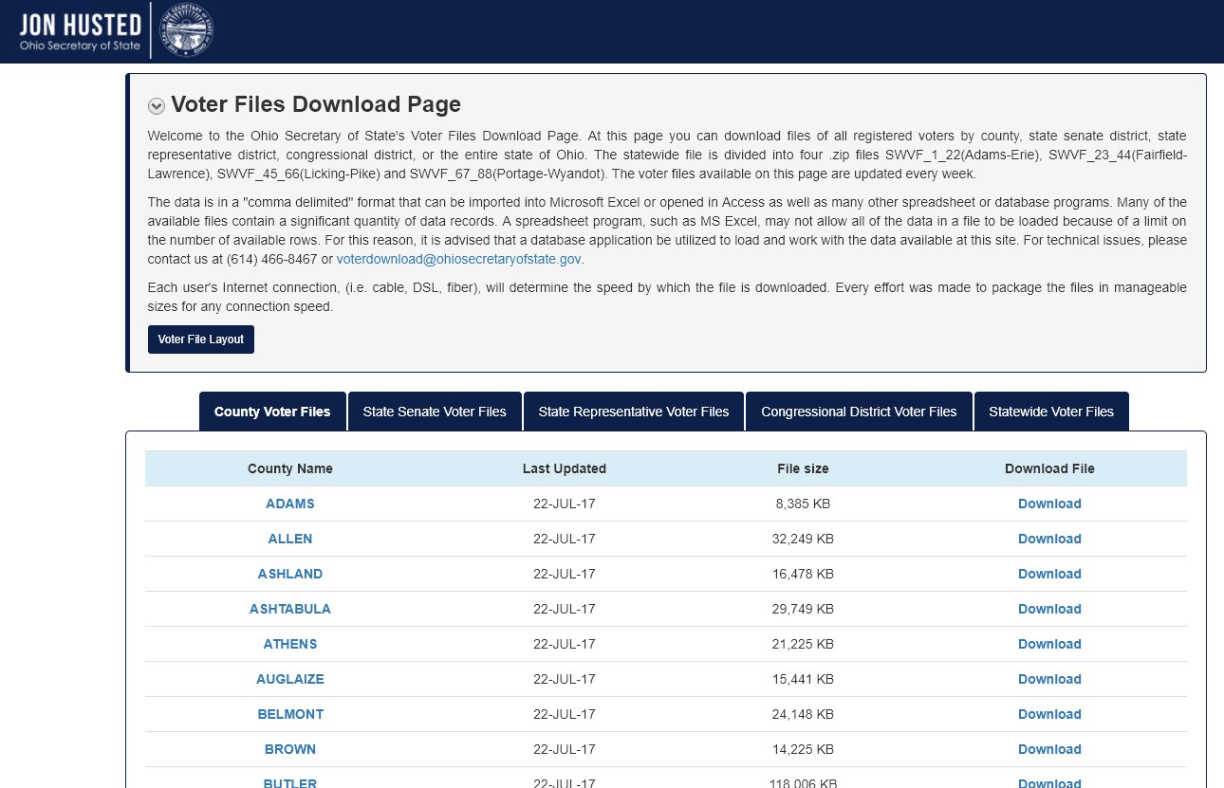
Public Data Winner!
Ohio Voter Registration Database

Slide 28
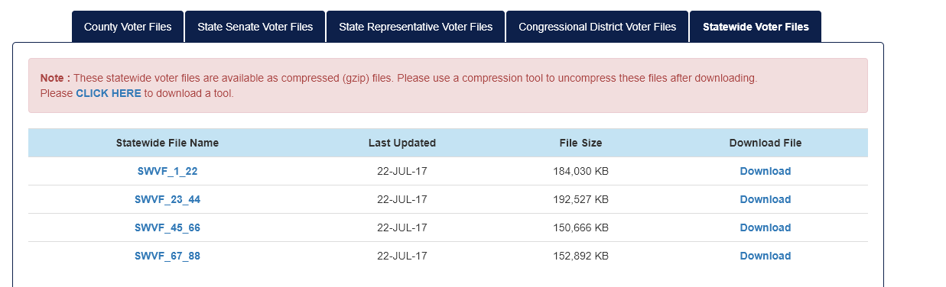
They even let you download the whole state…

Slide 29
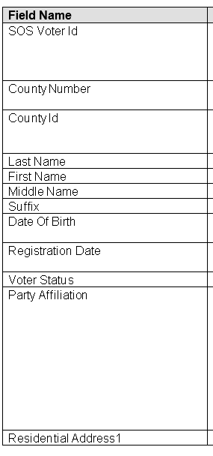
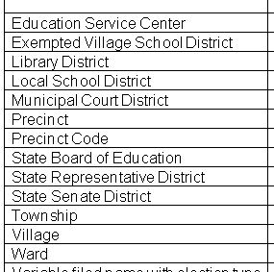
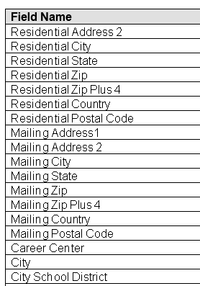
Some things it includes….

Slide 30

Now that we have our seed data, let’s get personal…

Slide 31

Sources of Personal Information
Facebook - Interests, Current City/State, Original City/State, Relationships, Degree, Schools attended, Jobs
Twitter - Current thoughts?
LinkedIn - Job experience
Pipl API - Everything….. No seriously… Everything….
Instagram - Shitty selfies

Slide 32

Scraping Facebook 101

Slide 33
Things to know about Facebook
They don’t like you scraping their data.
Their data comes back in ajax layers which makes it difficult to identify when the data you want is really on the page.
Facebook elements can be scraped by focusing on automation strings
Multi-pass scraping

Slide 34
Facebook URL to note
Allows you to query Facebook for people (authenticated and unauthenticated) seemingly endlessly without rate limits.
https://www.facebook.com/search/people/?q=
Example Query:
"https://www.facebook.com/search/people/?q=John+Smith+Ohio”

Slide 35
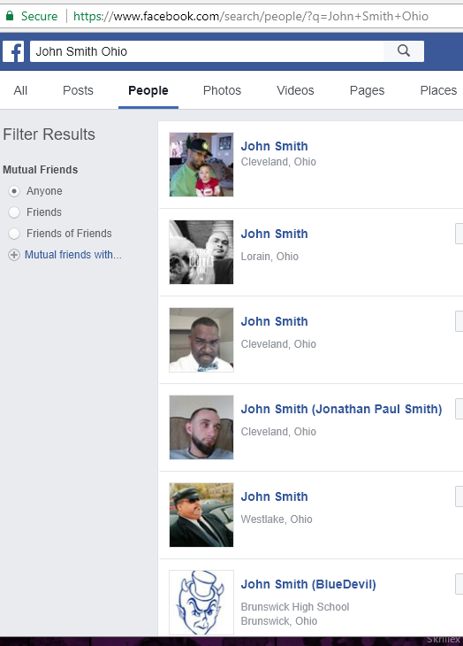
Results of the query request These results contain link to profile page, name, location, profile image.

Slide 36
How do we Scrape Facebook?

Slide 37
Tools I tried to Automate
curl | wget | Lynx – Couldn’t get it to execute embedded ajax
WPF WebBrowser – Function calls are limited compared to WinForms browser
WinForms Browser – Has a Memory leak built into the browser’s history cache

Slide 38
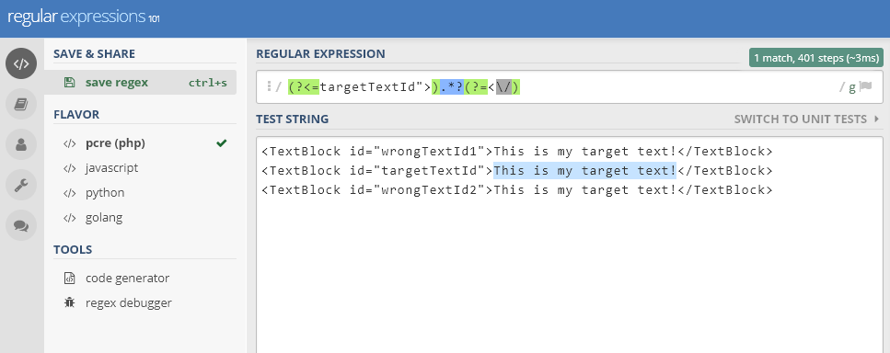
Testing your Regexes
Regex101.com (for testing)

Slide 39
C# WinForms Browser that pulls Source (not as dumb as it sounds) WinForms Browser -> Takes URL CMD Line Arg -> Returns HTML String

Slide 40

It’s not that bad…

Slide 41
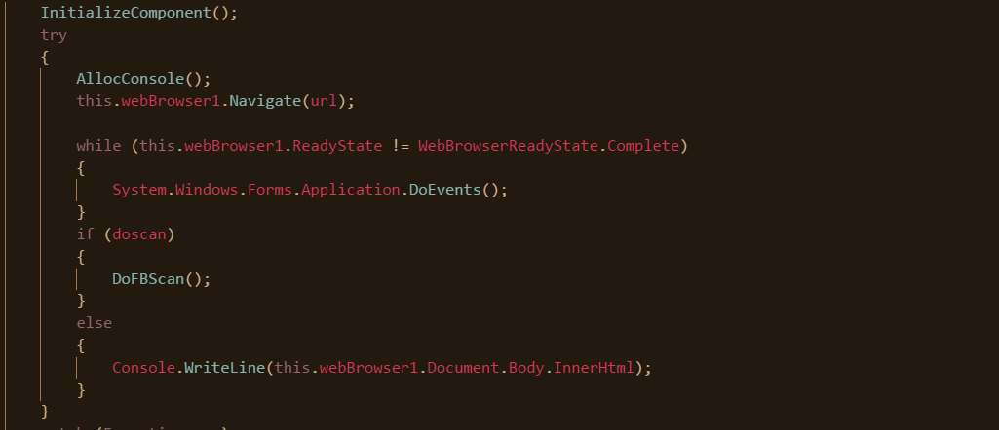
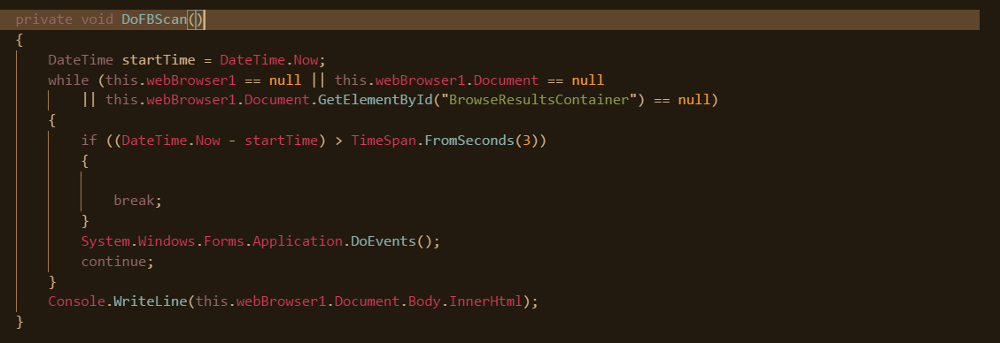
When you are running searches for people. The page will load an element with the ID BrowseResultsContainer when ready

Slide 42

I can Regex and so Can you!

Slide 43
Regex allows you to Scrape the Planet
With regex we can reach into complex website source and abstract data that we can use for analysis
I’m not a pro, I use one regex format over and over
(Positive Look Behind)
Match zero to unlimited, with as few matches as possible
(Positive Look Ahead)

Slide 44
Breaking the Regex Down

Slide 45
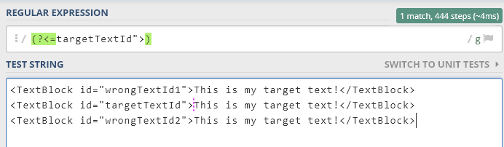
Positive Look Behind
(?<=YOURTEXT)

Slide 46
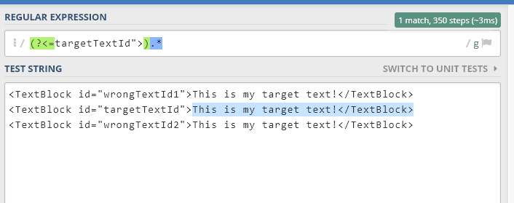
Match between zero and unlimited
.*

Slide 47
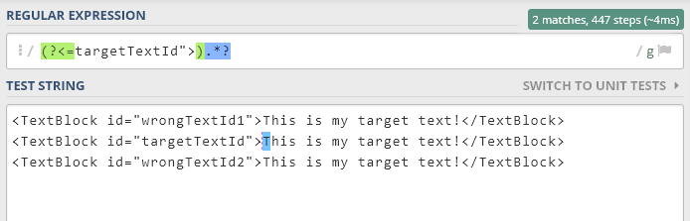
Match between zero and unlimited as few times as possible (lazy)
.*?

Slide 48
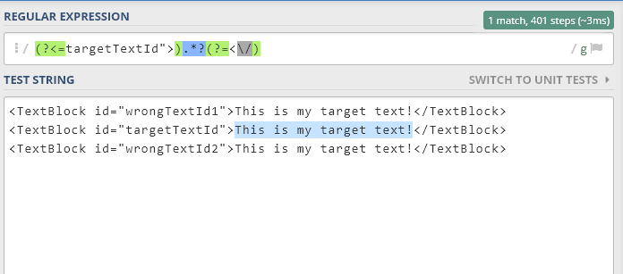
Positive Look Ahead
(?=YOURTEXT)

Slide 49
So how do we get the profile URLs?

Slide 50
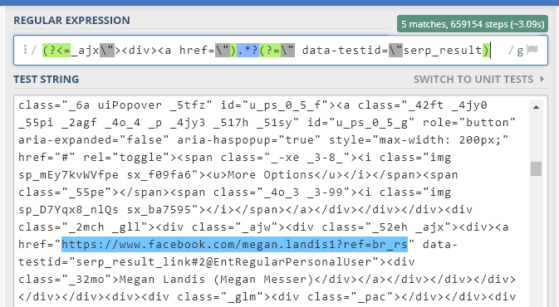
Extracting the usernames

Slide 51
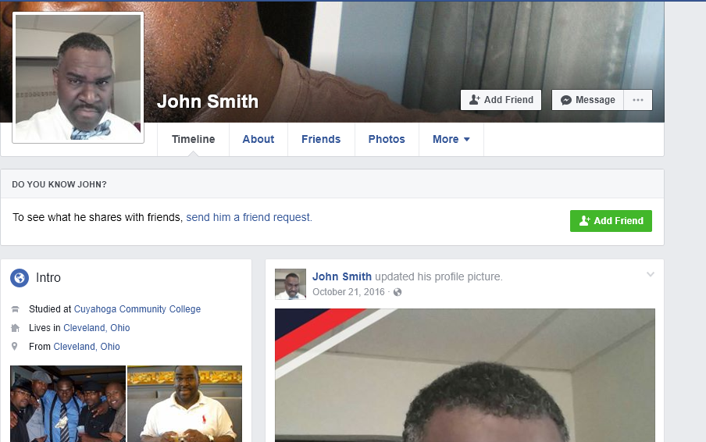

How do we get the profile page info?

Slide 52
Chunk it up…. Use multi-pass regex scraping to easily get details

Slide 53
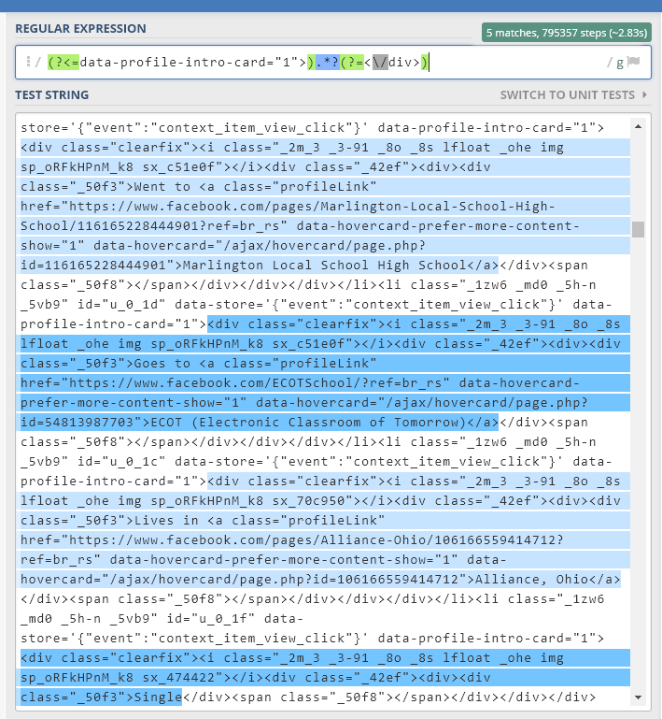
First Pass
REGEX:
(?<=data-profile-intro-card="1">).*?(?=<\/div>)
PAGE SCRAPED:
The user’s profile page (Either authenticated or unauthenticated)
RESULT:
In this instance it matches 5 blocks of information that we can cache and send out for further processing.

Slide 54
Marlinton Local School High School
ECOT (Electronic Classroom of Tomorrow)
Alliance Ohio

Slide 55
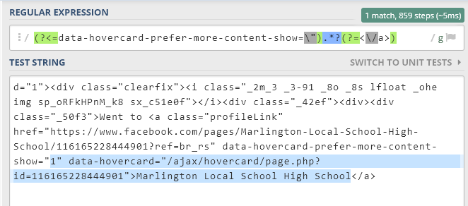
Second Pass

Slide 56
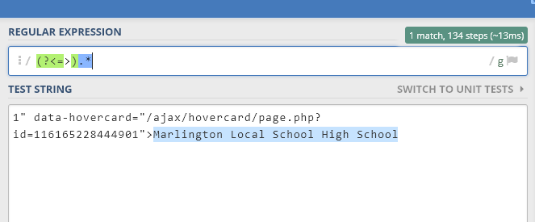
Third Pass

Slide 57
Now we have our seed data and our personal information. Let’s tie it together!

Slide 58
Gluing it All Together

Slide 59
At this point we have…
A result from the Voter DB
A series of Facebook Profiles that might match our voter DB record
Our Facebook profiles are parsed apart and ready for analysis

Slide 60
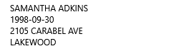
Our Voter DB Record
I queried for 18 year olds in Lakewood Ohio and picked a random person

Slide 61
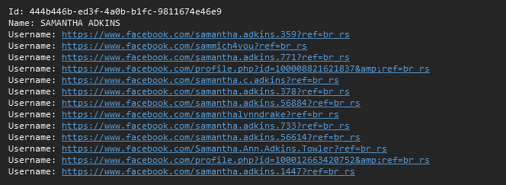
Now we query Facebook for our target
https://www.facebook.com/search/people/?q=Samantha+Adkins+Ohio

Slide 62
Now that we have the user profile URLs we can scrape each for it’s details and compare it to what we know so far

Slide 63
Building Confidence Scores

Slide 64
Comparison Engine
In order to figure out what profile is the target’s, we build confidence scores.
Name (total of .3 points)
First Name +.15 points
Last Name +.15 points
City and State
City and State found +.7 points
Just state found +.1 points
Just city found +.4 points

Slide 65
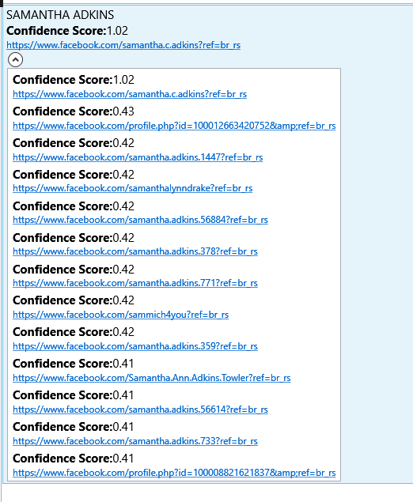
Profile URLs with scores next to them
Top scoring profile is a 1.02 !
The next closest is .43 so the top one is likely our target

Slide 66
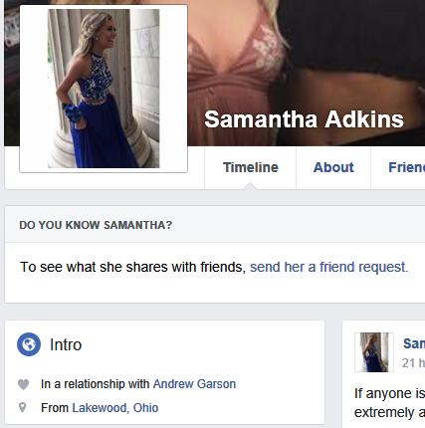
Navigating to the page confirms that we found the Facebook profile of
A Young Woman
Named Samantha Adkins
From Lakewood Ohio

Slide 67
What do we know?
At this point we now have Samantha’s
Full legal name
Home address
Date of birth
Photo (s)
Interests
Relationship status
Partner
Other Personal information

Slide 68
We can get more though….

Slide 69
What if we did this in reverse?

Slide 70
Instead of starting with the Voter DB, what if we used Facebook to search for specific targets and then resolved their home address and more?

Slide 71
What if we searched for people that worked for….
USPS
Cleveland Police Department
Cleveland Fire Department
Perry Nuclear Power Plant
Ohio National Guard

Slide 72
Live Demo of Alohomora

Slide 73

Who Cares?

Slide 74
Who cares about this data?
Critical infrastructure is a target of foreign agents
Police are a target of local criminals
Young people are targets of predators

Slide 75
Going Nuclear
Nuclear Power Plants have been in the news recently as phishing targets for hackers.
In our example we acquired a lot of information on a nuclear plant worker.

Slide 76
What Would I Do About it?

Slide 77
Summary
You can’t opt out of the internet
Voting, getting tickets, and owning a dog shouldn’t be opting into big data marketing.
Laws need to catch up

Slide 78
Contact
Twitter: @DotNetRussell
Blog: DotNetRussell.com
GitHub: github.com/DotNetRussell
Alohomora Code is on my Github and available for download now along with this slide deck.
Like my work and want to donate some Satoshis?
https://www.dotnetrussell.com/index.php/donate/

